Slide 1
Capacitance & Dielectrics
Definition of capacitance
Calculating capacitance of capacitors with simple geometries
Combination of capacitors
Circuit symbols to represent capacitors connected to batteries
Energy stored in a charged capacitor
Capacitors with dielectrics
Introduction

Slide 2
Circuits and Circuit Elements
Electric circuits are the basis for the vast majority of the devices used in society.
Circuit elements can be connected with wires to form electric circuits.
Capacitors are one circuit element.
Others will be introduced in other chapters
Capacitors
Capacitors are devices that store electric charges.
Examples of where capacitors are used include:
radio receivers
filters in power supplies
to eliminate sparking in automobile ignition systems
energy-storing devices in electronic flashes
Introduction

Slide 3
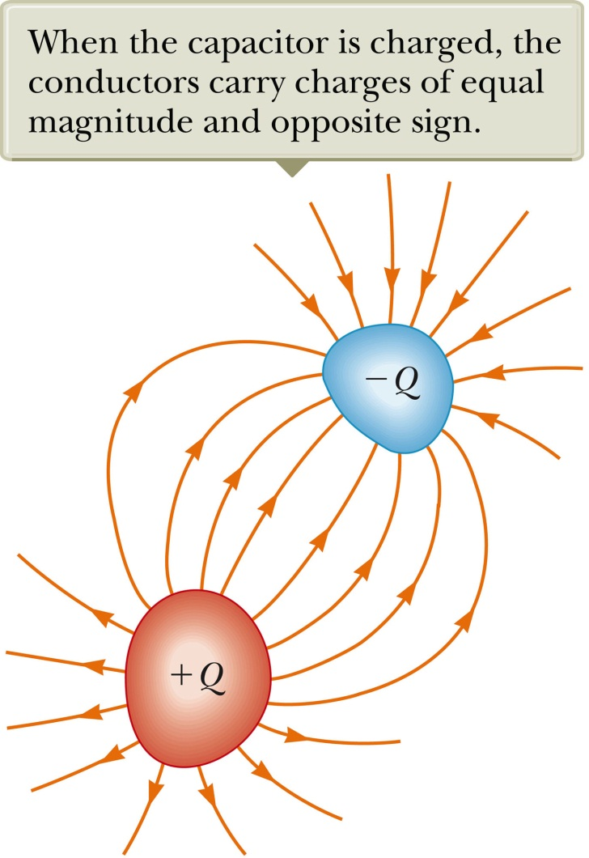
Makeup of a Capacitor
A capacitor consists of two conductors.
These conductors are called plates.
When the conductor is charged, the plates carry charges of equal magnitude and opposite signs.
A potential difference exists between the plates due to the charges.
Section 26.1

Slide 4
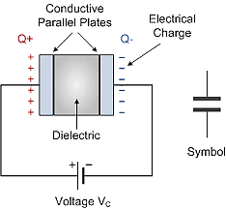
Definition of Capacitance
The capacitance, C, of a capacitor is defined as the ratio of the magnitude of the charge on either conductor to the potential difference between the conductors.
The SI unit of capacitance is the farad (F).
The farad is a large unit, typically you will see
microfarads (μF) and picofarads (pF).
Capacitance will always be a positive quantity.
The capacitance of a given capacitor is constant.
The capacitance is a measure of the capacitor’s ability to store charge.
The capacitance of a capacitor is the amount of charge the capacitor can store per unit of potential difference.
Section 26.1

Slide 5
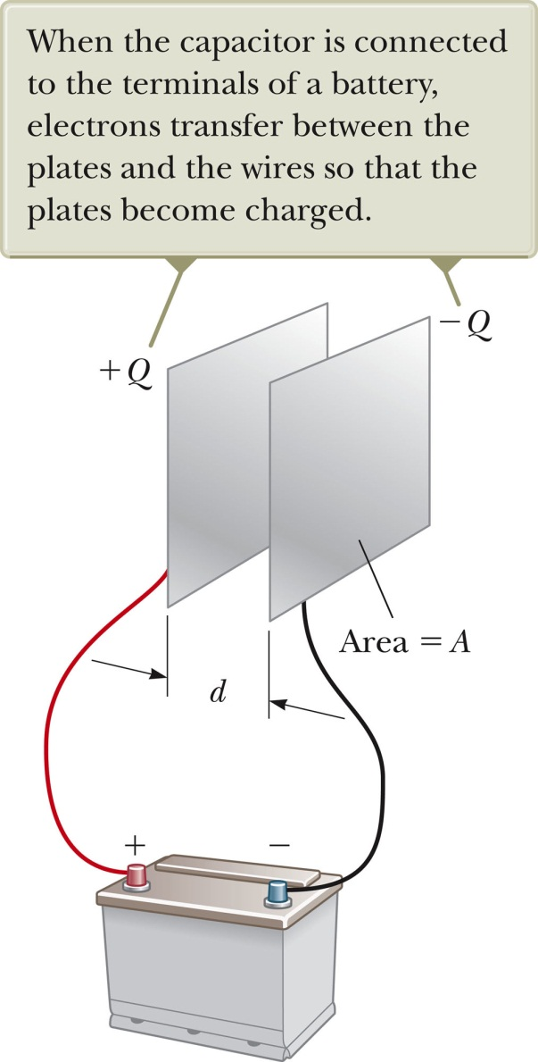
Parallel Plate Capacitor
Each plate is connected to a terminal of the battery.
The battery is a source of potential difference.
If the capacitor is initially uncharged, the battery establishes an electric field in the connecting wires.
This field applies a force on electrons in the wire just outside of the plates - > electrons moving onto the negative plate - > continues until equilibrium is achieved: plate, wire & terminal at the same potential.
At this point, there is no field present in the wire and the movement of the electrons ceases - > plate negatively charged; A similar process occurs at the other plate.
In its final configuration, the potential difference across the capacitor plates is the same as that between the terminals of the battery.
Section 26.1

Slide 6

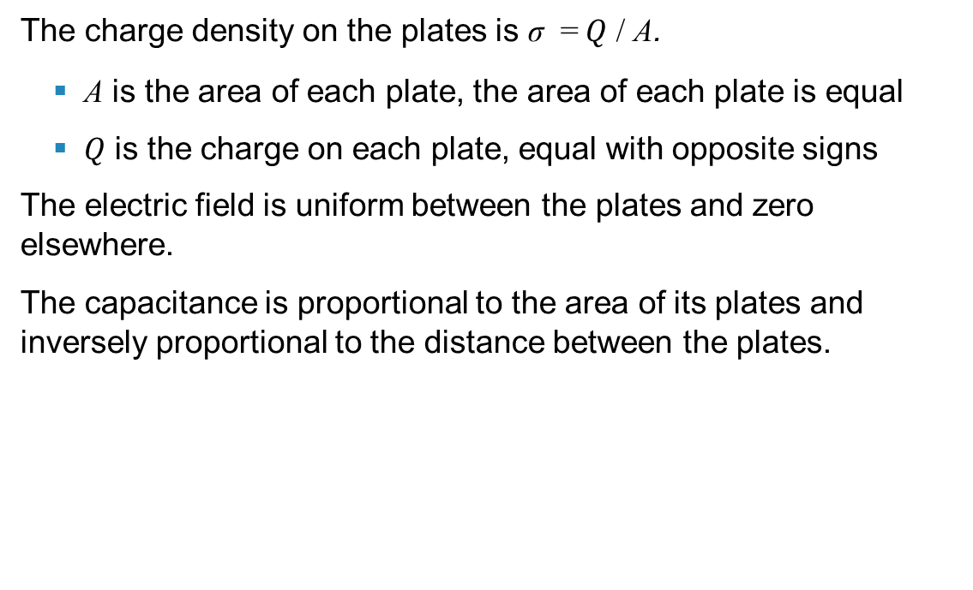
Capacitance – Parallel Plates
The charge density on the plates is σ = $Q$ / A.
A is the area of each plate, the area of each plate is equal
$Q$ is the charge on each plate, equal with opposite signs
The electric field is uniform between the plates and zero elsewhere.
The capacitance is proportional to the area of its plates and inversely proportional to the distance between the plates.
$$C=\frac{Q}{ΔV}=\frac{Q}{Ed}=\frac{ε_{o}Q}{σd}=\frac{ε_{o}Q}{(Q/A)d}=\frac{ε_{o}A}{d}$$
Section 26.2

Slide 7
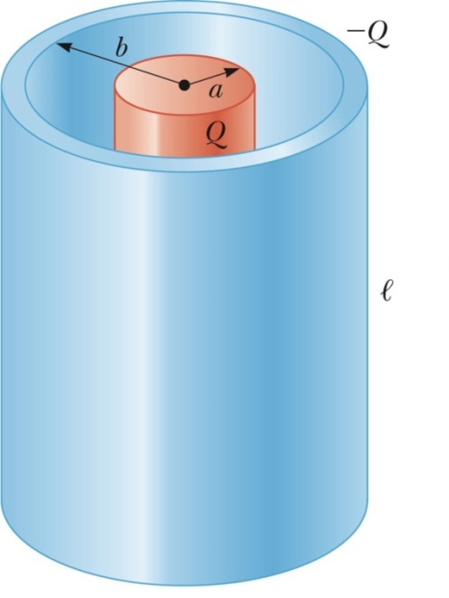
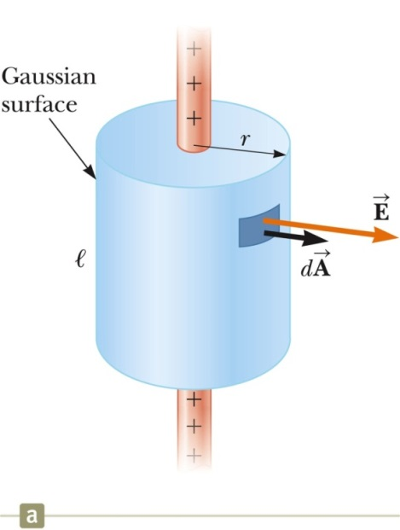


Capacitance - Cylindrical Capacitors (Optional)
From Chapter 24
$$2$$
$$2$$
Section 26.2

Slide 8
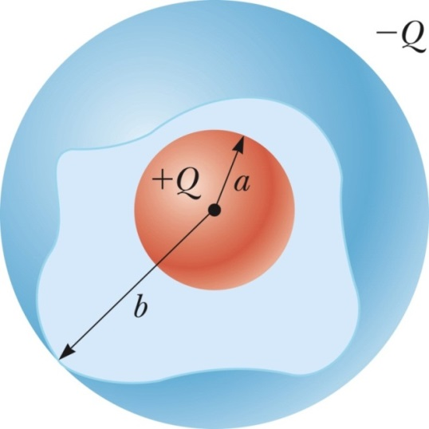
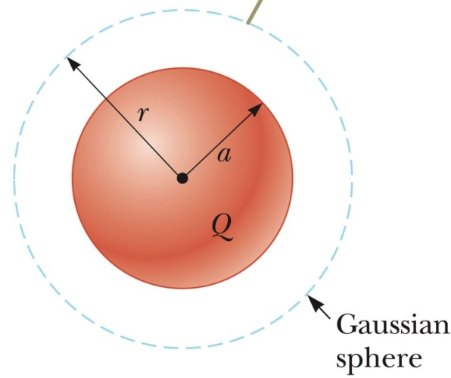
Capacitance - Spherical Capacitor (Optional)
From Chapter 24
Section 26.2

Slide 9

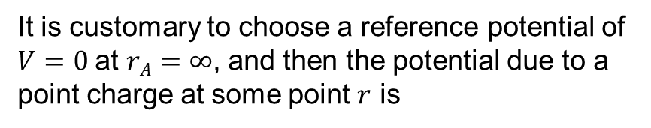
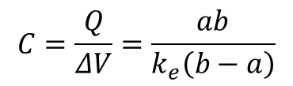
Capacitance – Isolated Sphere (Optional)
Assume a spherical charged conductor with radius $a$.
The sphere will have the same capacitance as it would if there were a conducting sphere of infinite radius ($b→∞$), concentric with the original sphere.
Assume $V=0$for the infinitely large shell
Note, this is independent of the charge
on the sphere and its potential.
From previous page
$$C=\frac{Q}{ΔV}=\frac{ab}{k_{e}\left(b−a\right)}$$
Section 26.2

Slide 10
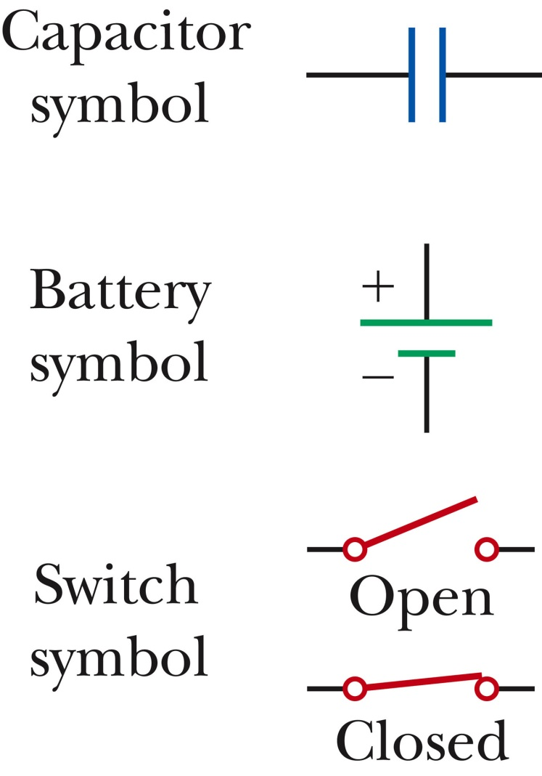
Circuit Symbols
A circuit diagram is a simplified representation of an actual circuit.
Circuit symbols are used to represent the various elements.
Lines are used to represent wires.
The battery’s positive terminal is indicated by the longer line.
Section 26.3

Slide 11
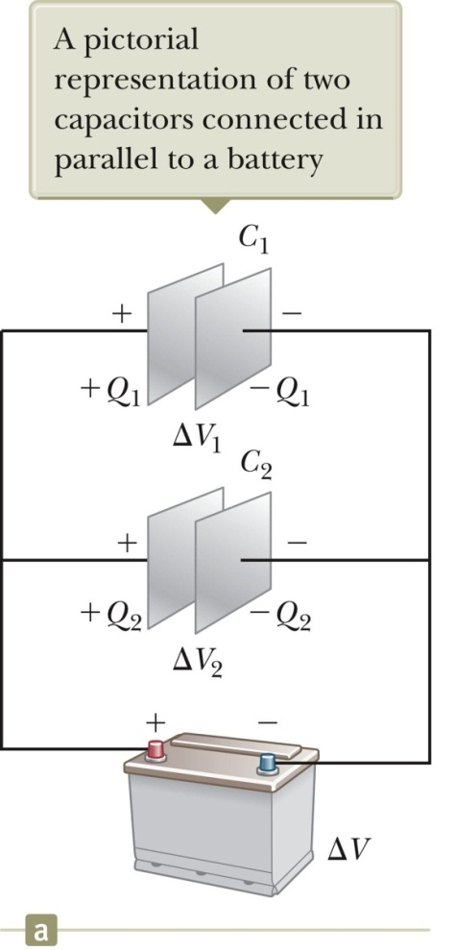
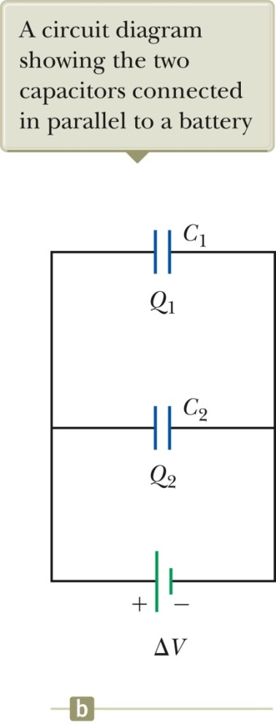
Capacitors in Parallel
The potential difference across the capacitors is the same.
And each is equal to the voltage of the battery
ΔV₁ = ΔV₂ = ΔV
ΔV is the battery terminal voltage
The total charge is equal to the sum of the charges on the capacitors.
Q_{tot} = Q₁ + Q₂
Section 26.3

Slide 12
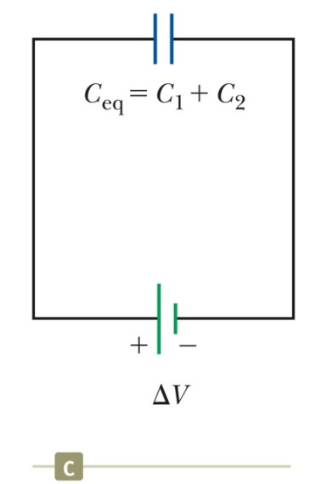
Capacitors in Parallel (Equivalent capacitance)
The capacitors can be represented by one capacitor with a capacitance of C_{eq.}
ΔV₁ = ΔV₂ = ΔV
Q_{tot} = Q₁ + Q₂
Q_{tot} = Q₁ + Q₂
= C₁ΔV₁ + C₂ΔV₂
= C₁ΔV + C₂ΔV
Therefore,
C_{eq} = Q_{tot} /ΔV = C₁ + C₂
Equivalent to
C_{eq} = C₁ + C₂ + C₃ + … (parallel combination)
Section 26.3

Slide 13
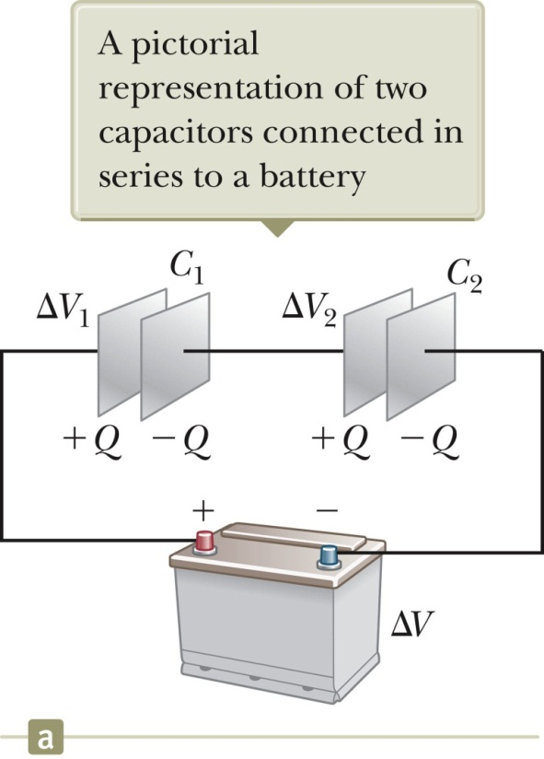
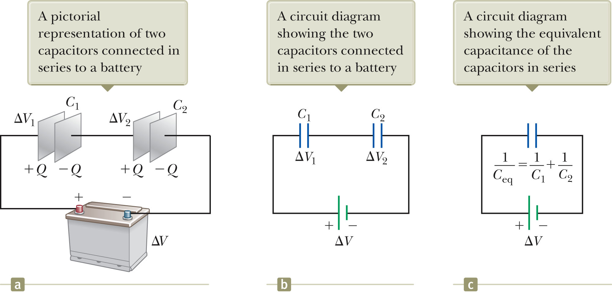
Capacitors in Series
The potential differences (ΔV₁ and ΔV₂) across the capacitors are NOT the same.
The total potential is
ΔV = ΔV₁ + ΔV₂
The charge on each capacitor is same.
Q₁ = Q₂ = Q
Section 26.3

Slide 14
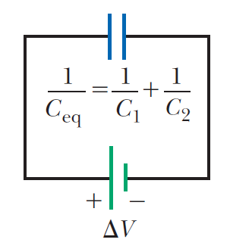
Capacitors in Series (Equivalent capacitance)
The capacitors can be represented by one capacitor with a capacitance of C_{eq.}
Q₁ = Q₂ = Q
ΔV_{tot} = ΔV₁ + ΔV₂
Q/C_{eq} = ΔV_{tot} = ΔV₁ + ΔV₂ = Q₁/C₁ + Q₂/C₂
Therefore,
1/C_{eq} = 1/C₁ + 1/C₂
Equivalent to
(series combination)
Section 26.3

Slide 15
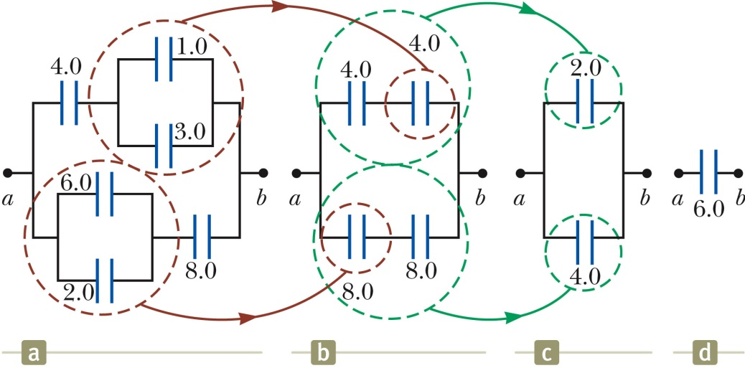
Equivalent Capacitance, Example
The 1.0-mF and 3.0-mF capacitors are in parallel.
The 6.0-mF and 2.0-mF capacitors are in parallel.
These parallel combinations are in series with the capacitors next to them.
The series combinations are in parallel and the final equivalent capacitance can be found.

Slide 16
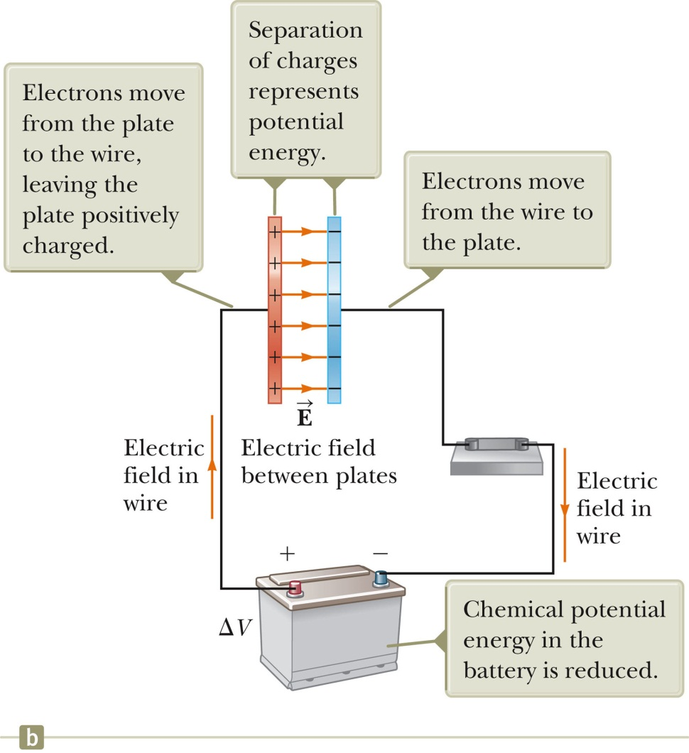
Energy in a Capacitor – Overview
Consider the circuit to be a system.
Before the switch is closed, the energy is stored as chemical energy in the battery.
When the switch is closed, the energy is transformed from chemical potential energy to electric potential energy.
The electric potential energy is related to the separation of the positive and negative charges on the plates.
A capacitor can be described as a device that stores energy as well as charge.
Section 26.4

Slide 17
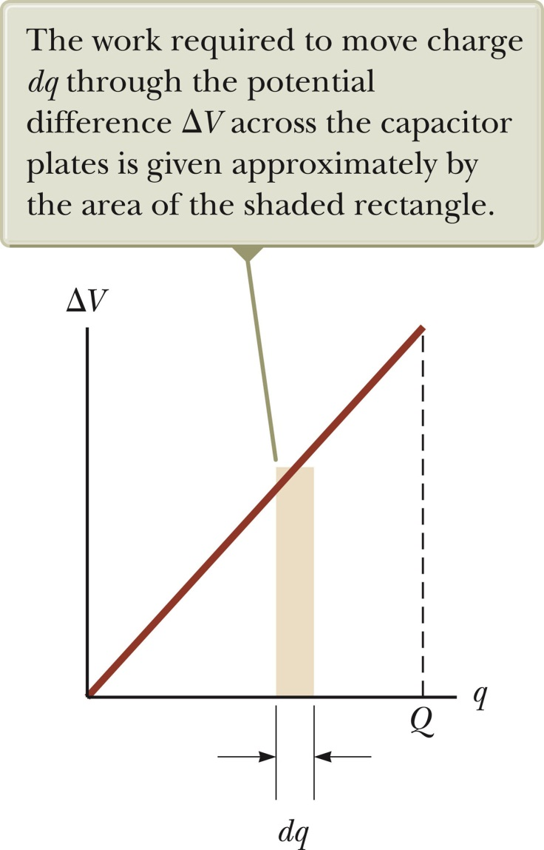
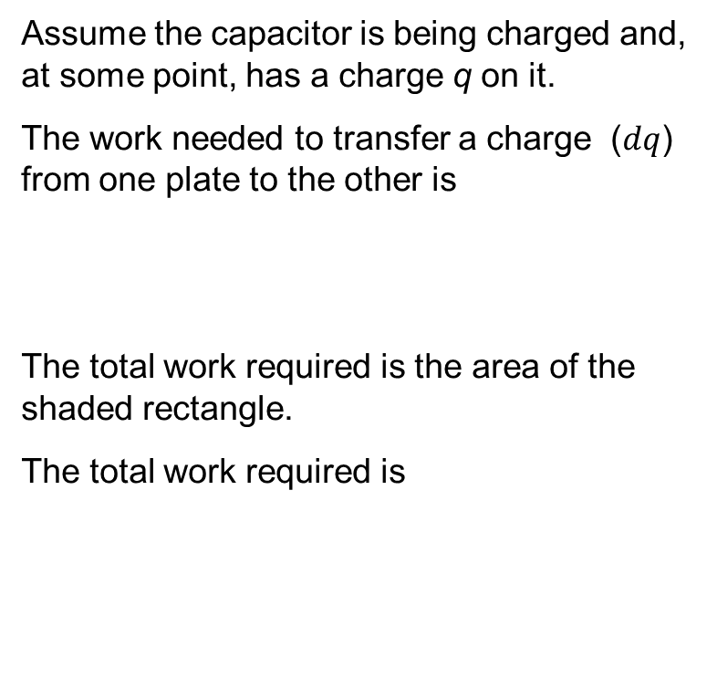
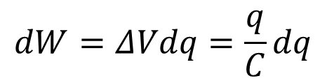
Energy Stored in a Capacitor
Assume the capacitor is being charged and, at some point, has a charge q on it.
The work needed to transfer a charge ($dq$) from one plate to the other is
The total work required is the area of the shaded rectangle.
The total work required is
$$dW=ΔVdq=\frac{q}{C}dq$$
Section 26.4

Slide 18
Energy, cont
The work done in charging the capacitor appears as electric potential energy U:
This applies to a capacitor of any geometry.
The energy stored increases as the charge increases and as the potential difference increases.
In practice, there is a maximum voltage before discharge occurs between the plates.
The energy can also be considered to be stored in the electric field.
For a parallel-plate capacitor, the energy can be expressed in terms of the field as
U = ½ (ε_{o}A/d) (E²d²) = ½ (ε_{o}Ad)E².
It can also be expressed in terms of the energy density (energy per unit volume)
u_{E} = U/Ad = ½ ε_{o}E².
Section 26.4

Slide 19
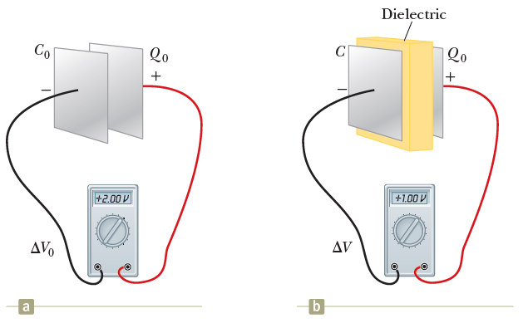
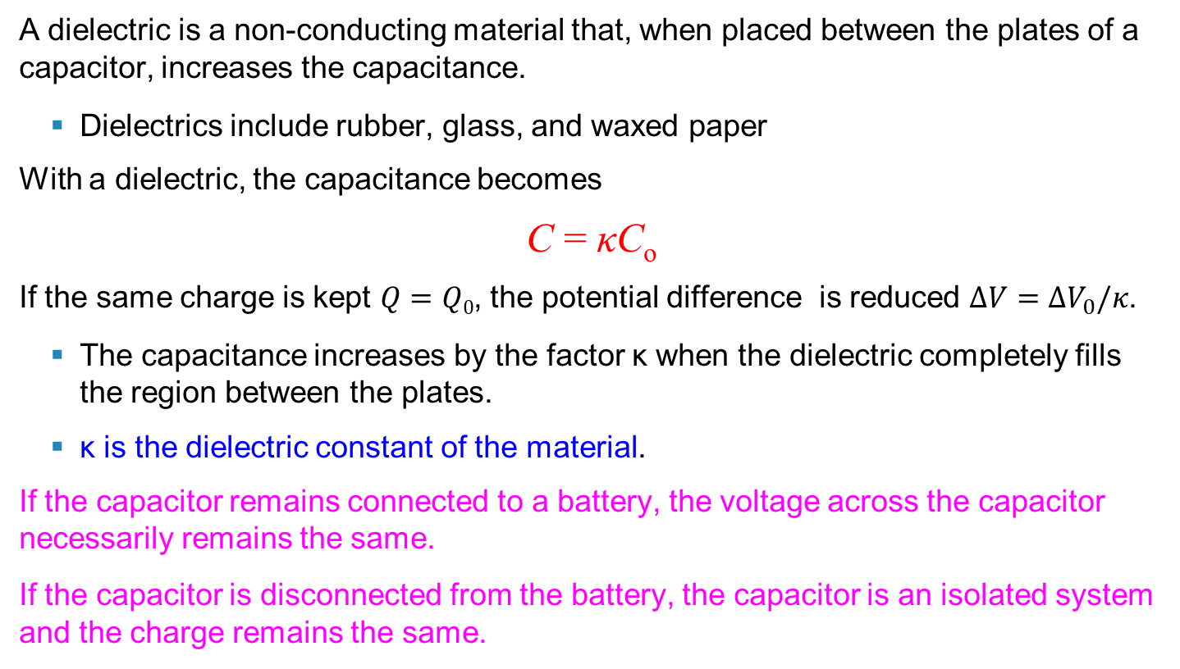
Capacitors with Dielectrics
A dielectric is a non-conducting material that, when placed between the plates of a capacitor, increases the capacitance.
Dielectrics include rubber, glass, and waxed paper
With a dielectric, the capacitance becomes
C = κC_{o}
If the same charge is kept $Q=Q0$, the potential difference is reduced $ΔV=ΔV_{0}/κ$.
The capacitance increases by the factor κ when the dielectric completely fills the region between the plates.
κ is the dielectric constant of the material.
If the capacitor remains connected to a battery, the voltage across the capacitor necessarily remains the same.
If the capacitor is disconnected from the battery, the capacitor is an isolated system and the charge remains the same.
Section 26.5

Slide 20
Dielectrics, cont
For a parallel-plate capacitor,
C = κ (ε_{o}A) / d
In theory, d could be made very small to create a very large capacitance.
In practice, there is a limit to d.
d is limited by the electric discharge that could occur though the dielectric medium separating the plates.
For a given d, the maximum voltage that can be applied to a capacitor without causing a discharge depends on the dielectric strength of the material.
Dielectrics provide the following advantages:
Increase in capacitance
Increase the maximum operating voltage
Possible mechanical support between the plates
This allows the plates to be close together without touching.
This decreases d and increases C.
E_{max} ~ 1 V/μm.
If E > E_{max}, break down
Section 26.5

Slide 21
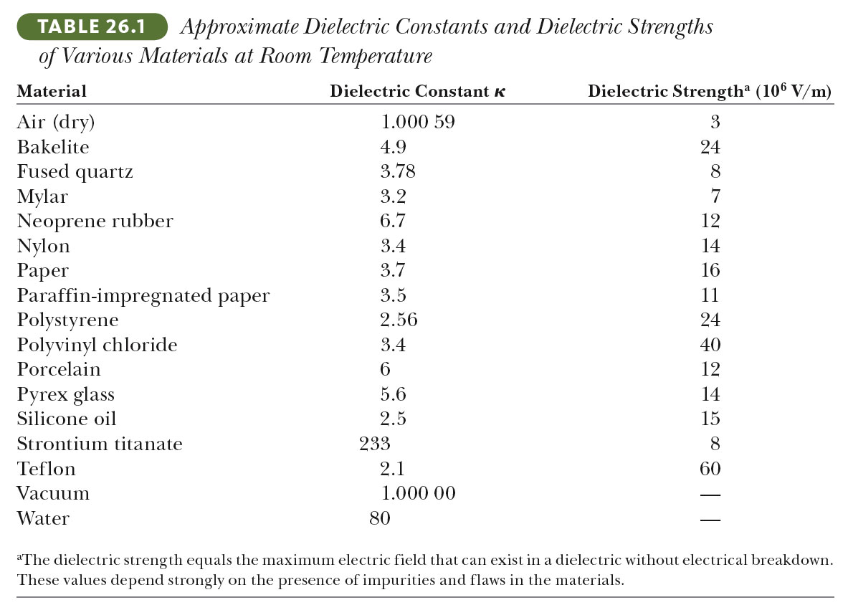
Some Dielectric Constants and Dielectric Strengths

Slide 22
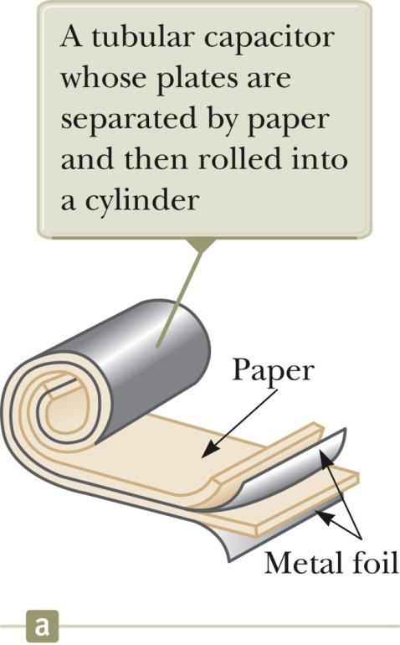
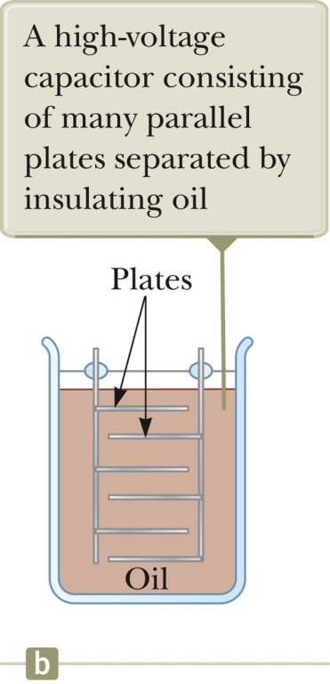
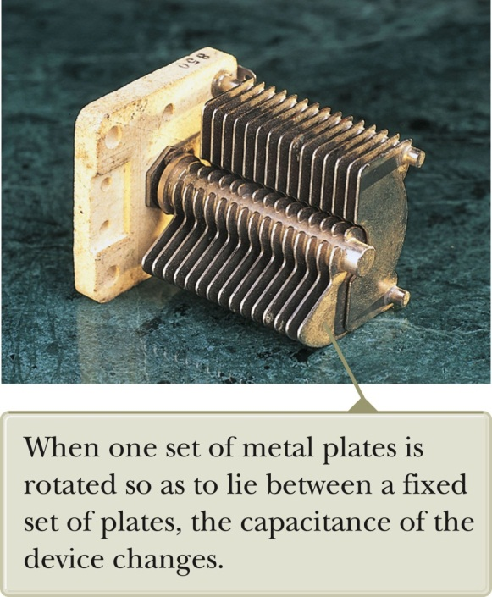
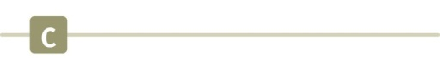
Types of Capacitors – Tubular, oil filled and electrolytic (Optional)
Metallic foil interlaced with thin sheets of paraffin-impregnated paper or Mylar. The layers are rolled into a cylinder to form a small package for the capacitor.
High-voltage capacitors. A number of interwoven metallic plates are immersed in silicon oil.
Variable capacitors consist of two interwoven sets of metallic plates. One plate is fixed and the other is movable (area changes). Contain air as the dielectric. C varying from 10 to 500 pF.
Section 26.5

Slide 23
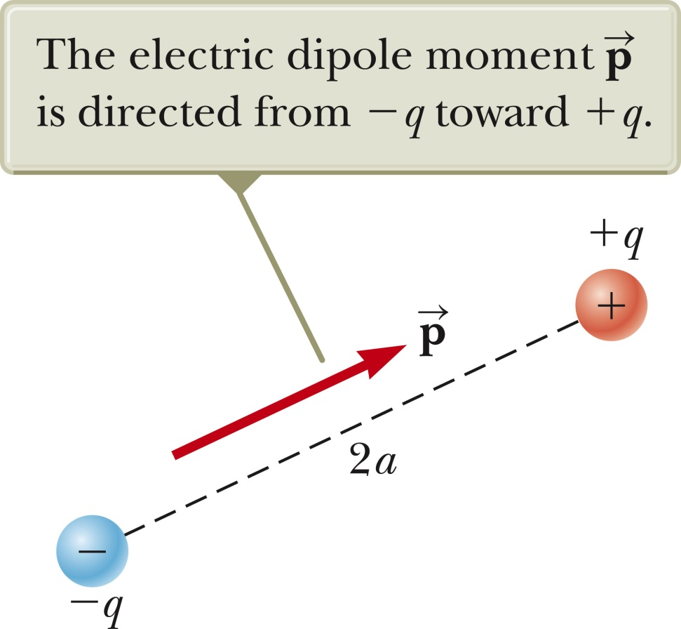
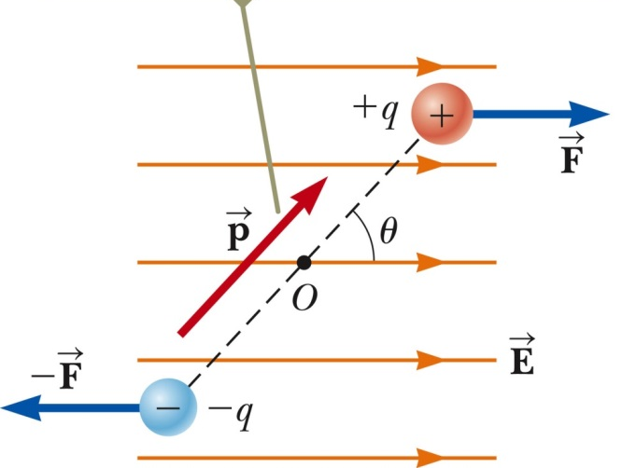
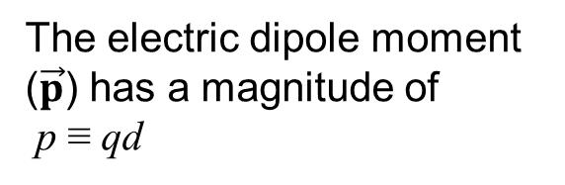
Electric Dipole (Optional)
An electric dipole consists of two charges of equal magnitude and opposite signs.
The electric dipole moment ($\vec{p}$) has a magnitude of p ≡ qd
An electric field can cause a dipole to change its orientation.
d
The charges are separated by d.

Slide 24
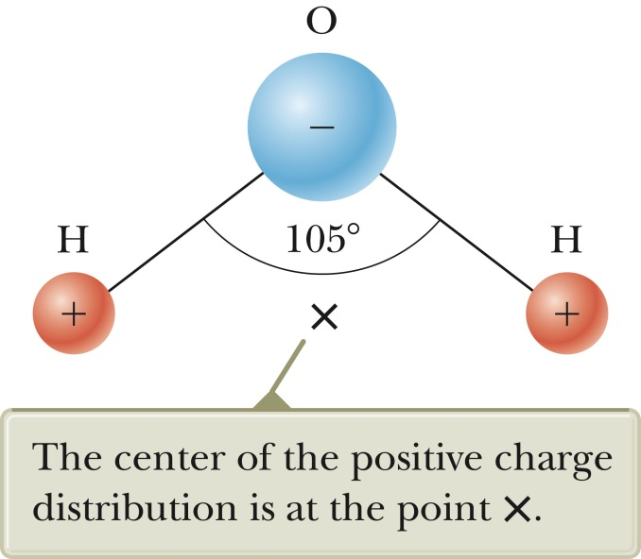

Polar vs. Nonpolar Molecules (Optional)
Before we apply electric field,
a molecule with a net dipole moment is called a polar molecule.
a molecule without a net dipole moment is called a nonpolar molecule.
Example:
Water molecule
A water molecule is an example of a polar molecule.
The center of the negative charge is near the center of the oxygen atom.
The x is the center of the positive charge distribution.
The dipole moment is pointing downward
$$\vec{p}$$

Slide 25
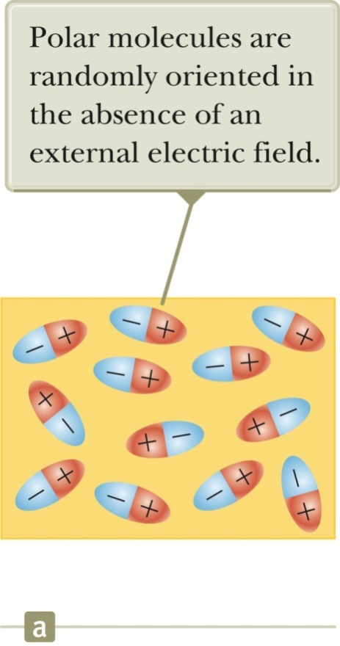
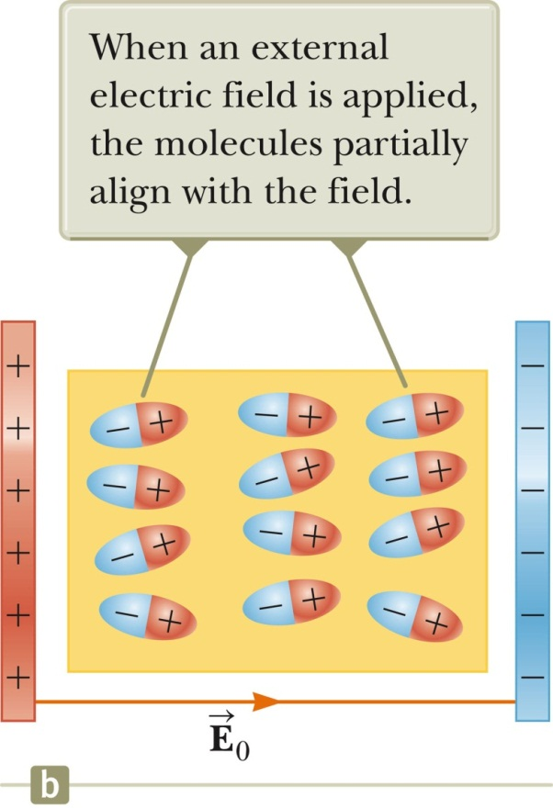
Dielectrics with polar molecules – An Atomic View
The polar molecules that make up the dielectric are modeled as dipoles.
The molecules are randomly oriented in the absence of an electric field.
An external electric field is applied - > torque
The molecules partially align with the field.
The degree of alignment depends on temperature and the magnitude of the field.

Slide 26
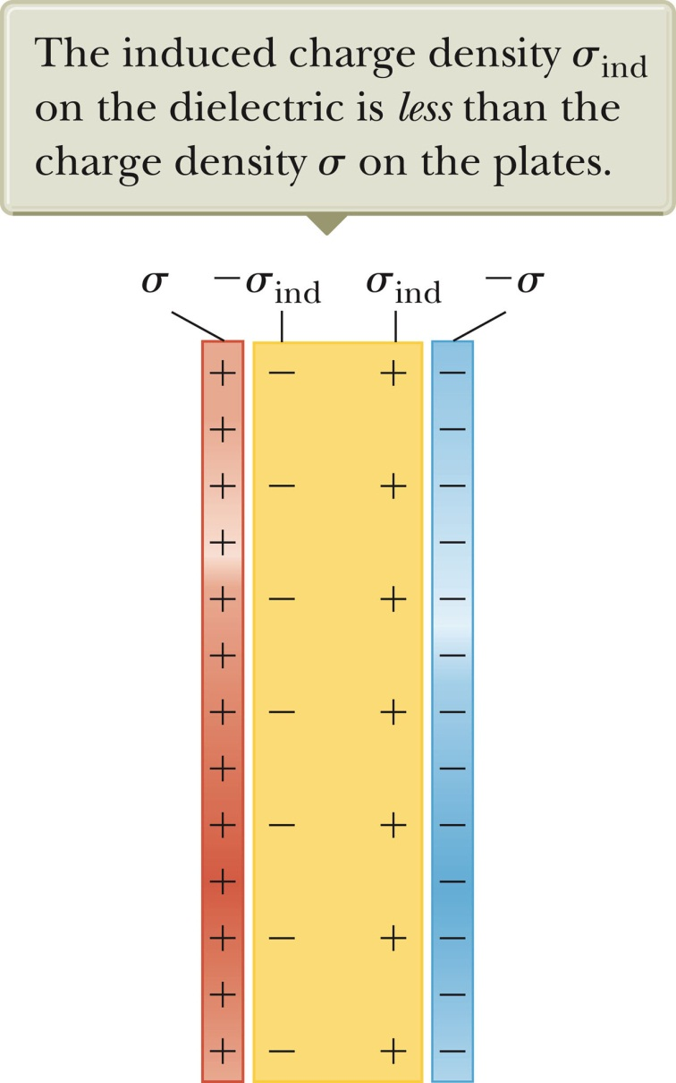
Dielectrics with nonpolar molecules – An Atomic View, 2
If the molecules of the dielectric are nonpolar molecules, the electric field produces some charge separation.
This produces an induced dipole moment. The effect is then the same as if the molecules were polar.
As a result, an external field can polarize the dielectric whether the molecules are polar or nonpolar.
The charged edges of the dielectric act as a second pair of plates producing an induced electric field in the direction opposite the original electric field.
Section 26.7

Slide 27
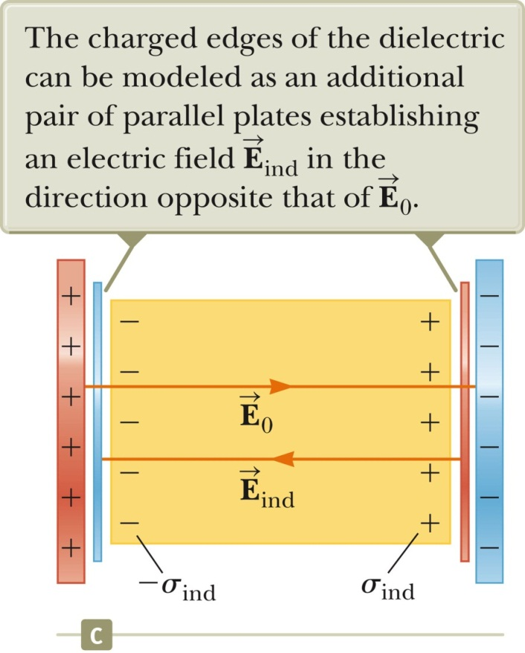
Induced Charge and Field
The electric field due to the plates is directed to the right and it polarizes the dielectric.
The net effect on the dielectric is an induced surface charge that results in an induced electric field.
If the dielectric were replaced with a conductor, the net field between the plates would be zero.
Section 26.7

